Slide 1
Williams international data transformation project
Simon lidwell

Slide 2
Agenda
Data Lakes
Data Movement
API
SQL Server
Kafka
RavenDB

Slide 3
Data Lakes
 |  | Elastic - Enterprise | Mongo | Couchbase Server - Enterprise | OrientDB | RavenDB - Professional | RavenDB - Enterprise
Strikes
Summary |  | ELK Stack is all in or all out Expected $200k+ for minimum stack | It does what we need There are some memory leak concerns with clients JVM tool so java expertise is necessary | Not a good fit | Company seems to be moving commercial offerings to FlexVertex Need to understand FlexVertex better | Professional is close but still not powerful enough | Enterprise satsifies almost all features Scalability cost is reasonable C# and javascript
Management | Description
License Limit |  | infinite | infinite | 60 cores | infinite | infinite | infinite
Eligible for Commecial Use |  | Yes | Yes | Yes | Yes | Yes | Yes
Number of Databases |  | infinite | infinite | infinite | infinite | infinite | infinite
Single Database Size |  | infinite | infinite | infinite | infinite | infinite | infinite
Management Studio (GUI) |  | Kibana |  | Couchbase Web Console | OrientDB Studio | RDB NoSQL DB Management Studio | RDB NoSQL DB Management Studio
Features | Description
Sharding | Ability to disperse data across various database servers | Yes | Yes | Auto-managed | Yes | Yes | Yes
Kafka Sink | Does this have a native funtionality to produce directly to Kafka with no other infrastructure? | No | No | Yes | No | Yes | Yes
Alternate Kafka Sink | Is there a tool to sink data? | Kafka Connect | Kafka Connect
HiveMQ Sink | Does this have a native functionality to sink mqtt messages directly to the db with no other existing infrastructure? | No | HiveMQ Enterprise Extension for MongoDB | No | No | No | No
Alternate HiveMQ Sink | Is there a tool to sink data? | HiveMQ Enterprise Extension | HiveMQ Enterprise Extension | HiveMQ Enterprise Extension | HiveMQ Enterprise Extension | HiveMQ Enterprise Extension | HiveMQ Enterprise Extension
Data Archival | Built-in archiving functionality for db backups? | Yes | No | No | No | Yes | Yes
SQL ETL | Support for SQL-like queries? | Yes | No | No | Yes | Yes | Yes
OLAP ETL | Support for OLAP? | Yes | No | No | No | Yes | Yes
Power BI | Built-in Power BI integration? | ODBC/JDBC | ODBC/JDBC | ODBC/JDBC | No | Direct | Direct
Grafana plugin for data |  | Yes | No | Couchbase datasource plugin | No | Yes | Yes
Extension Languages |  |  | Java |  |  |  | C#, Javascript
Time Series | Description
Time Series | Native implementation of collecting data points at regular time intervals and extracted with time-based queries | Yes | No | udfs | No | Yes | Yes
Incremental Time Series | Native implementation of deltas rather than absolute values, each point represents a change in value | No | No | udfs | No | Yes | Yes
Rollups & Retention |  | Yes | No | No | No | Yes | Yes
Cost
How they do cost |  |  | RAM Pool (64 GBs) | Per node |  | Per core | Per core
Total Price |  |  | 36,000 | 36,000 |  |  | 25,000

Slide 4
Data Movement: Part 1 of 2
Term | Definition | Examples
Data Ingestion | The process of collecting and importing data from various sources into a storage system or data processing environment. Data ingestion can handle structured, semi-structured, and unstructured data and may involve real-time or batch processing. | Reading data from APIs, databases, files, or streaming sources and loading it into data lakes, databases, or data warehouses.
Data Integration | The process of combining data from different sources to provide a unified view. Data integration involves extracting data from multiple sources, transforming it into a consistent format, and loading it into a target system. | Combining customer data from CRM systems, sales data from ERP systems, and transaction data from payment systems into a single reporting database.
ETL/ELT | ETL: A process where data is extracted from source systems, transformed into a suitable format or structure, and then loaded into a target system such as a data warehouse. ELT: Similar to ETL, but the transformation step happens after the data has been loaded into the target system. ELT is often used with modern cloud-based data warehouses where transformation can be performed efficiently. | ETL: Extracting data from a transactional database, transforming it into a format suitable for analytics, and loading it into a data warehouse. ELT: Loading raw data into a cloud data warehouse and then using the warehouse’s capabilities to perform transformations.
Data Mangement | The practice of managing and overseeing data assets to ensure their quality, security, and usability. It includes data governance, data quality, and data stewardship. | Ensuring data accuracy and consistency, implementing data privacy and security measures, and establishing policies for data usage.
Stream Processing | The real-time processing of continuous streams of data as they arrive. Stream processing systems handle data in motion, allowing for immediate analysis and action. | Real-time analytics on user activity logs, monitoring sensor data, or processing financial transactions as they occur.
Batch Processing | The processing of large volumes of data in chunks or batches, usually on a scheduled basis. Batch processing handles data that is collected over a period and processed together at a later time. | Running daily or hourly reports, processing end-of-day transactions, or performing data migrations.
Orchestration | The coordination and management of multiple tasks or processes to achieve a specific goal. In data workflows, orchestration involves scheduling, executing, and monitoring data processing tasks and pipelines. | Automating data pipelines, managing dependencies between tasks, and handling retries and failures in data processing workflows.

Slide 5
Data Movement: Part 2 of 2
Tool | Purpose | Free/Open-Source? | License Type | License Details | On-Prem? | Real-Time? | Subscribe to MQTT Natively? | Key Features
Benthos | Stream Processing | Yes | MIT License | Benthos is an open-source stream processing tool with no paid tiers. Its source code is available on GitHub. | Yes | Yes | Yes | * Single binary, easy to deploy * High performance * Integrates with various input/output sources * Config via YAML
Apache Nifi | Dataflow Automation | Yes | Apache License 2.0 | Apache Nifi is open-source and free to use. It is maintained by the Apache Software Foundation. | Yes | Yes | Yes | * Visual interface for designing data flows * Strong data provenance * High scalability * Extensible architecture
Prefect | Workflow Orchestration | Yes | Apache License 2.0 (Open-Source) | Prefect has an open-source version, but also offers a managed service (Prefect Cloud) with additional features and support. | Yes | No | No | * Python-based workflows * Flexible and dynamic workflows * Strong observability and logging
Apache Airflow | Workflow Orchestration | Yes | Apache License 2.0 | Apache Airflow is open-source and free to use, maintained by the Apache Software Foundation. Managed versions (like Astronomer) are available as paid services. | Yes | No | No | * DAGs for workflow management * Python-based tasks * Scheduler and web-based UI * Extensible with custom operators
Mage | Data Pipeline Tool | Yes | Apache License 2.0 | Mage has an open-source version, but also offers enterprise solutions with additional features and support. | Yes | No | Yes | * Visual and code based interface * Real-time and batch processing * Modular architecture * Collaboration features
Dagster | Data Orchestration | Yes | Apache License 2.0 (Open-Source) | Dagster is open-source, but there are commercial offerings for enterprise features and support. | Yes | No | No | * Python-based pipelines * Type-checked data flow * Strong observability * Module and reusable components
Node Red | Flow-based programming tool for IoT | Yes | Apache License 2.0 | Node-RED is open-source and free to use, developed by IBM and the open-source community. | Yes | Yes | Yes | * Visual programming interface * Lightweight and flexible * Extensible with custom nodes * Real-time processing

Slide 6
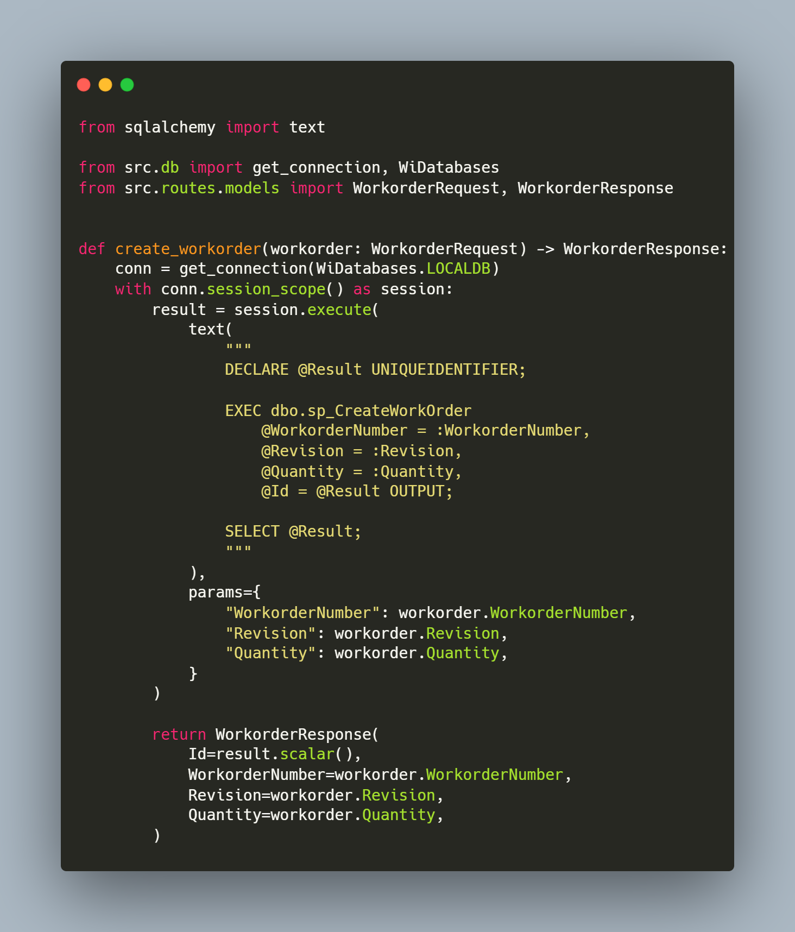
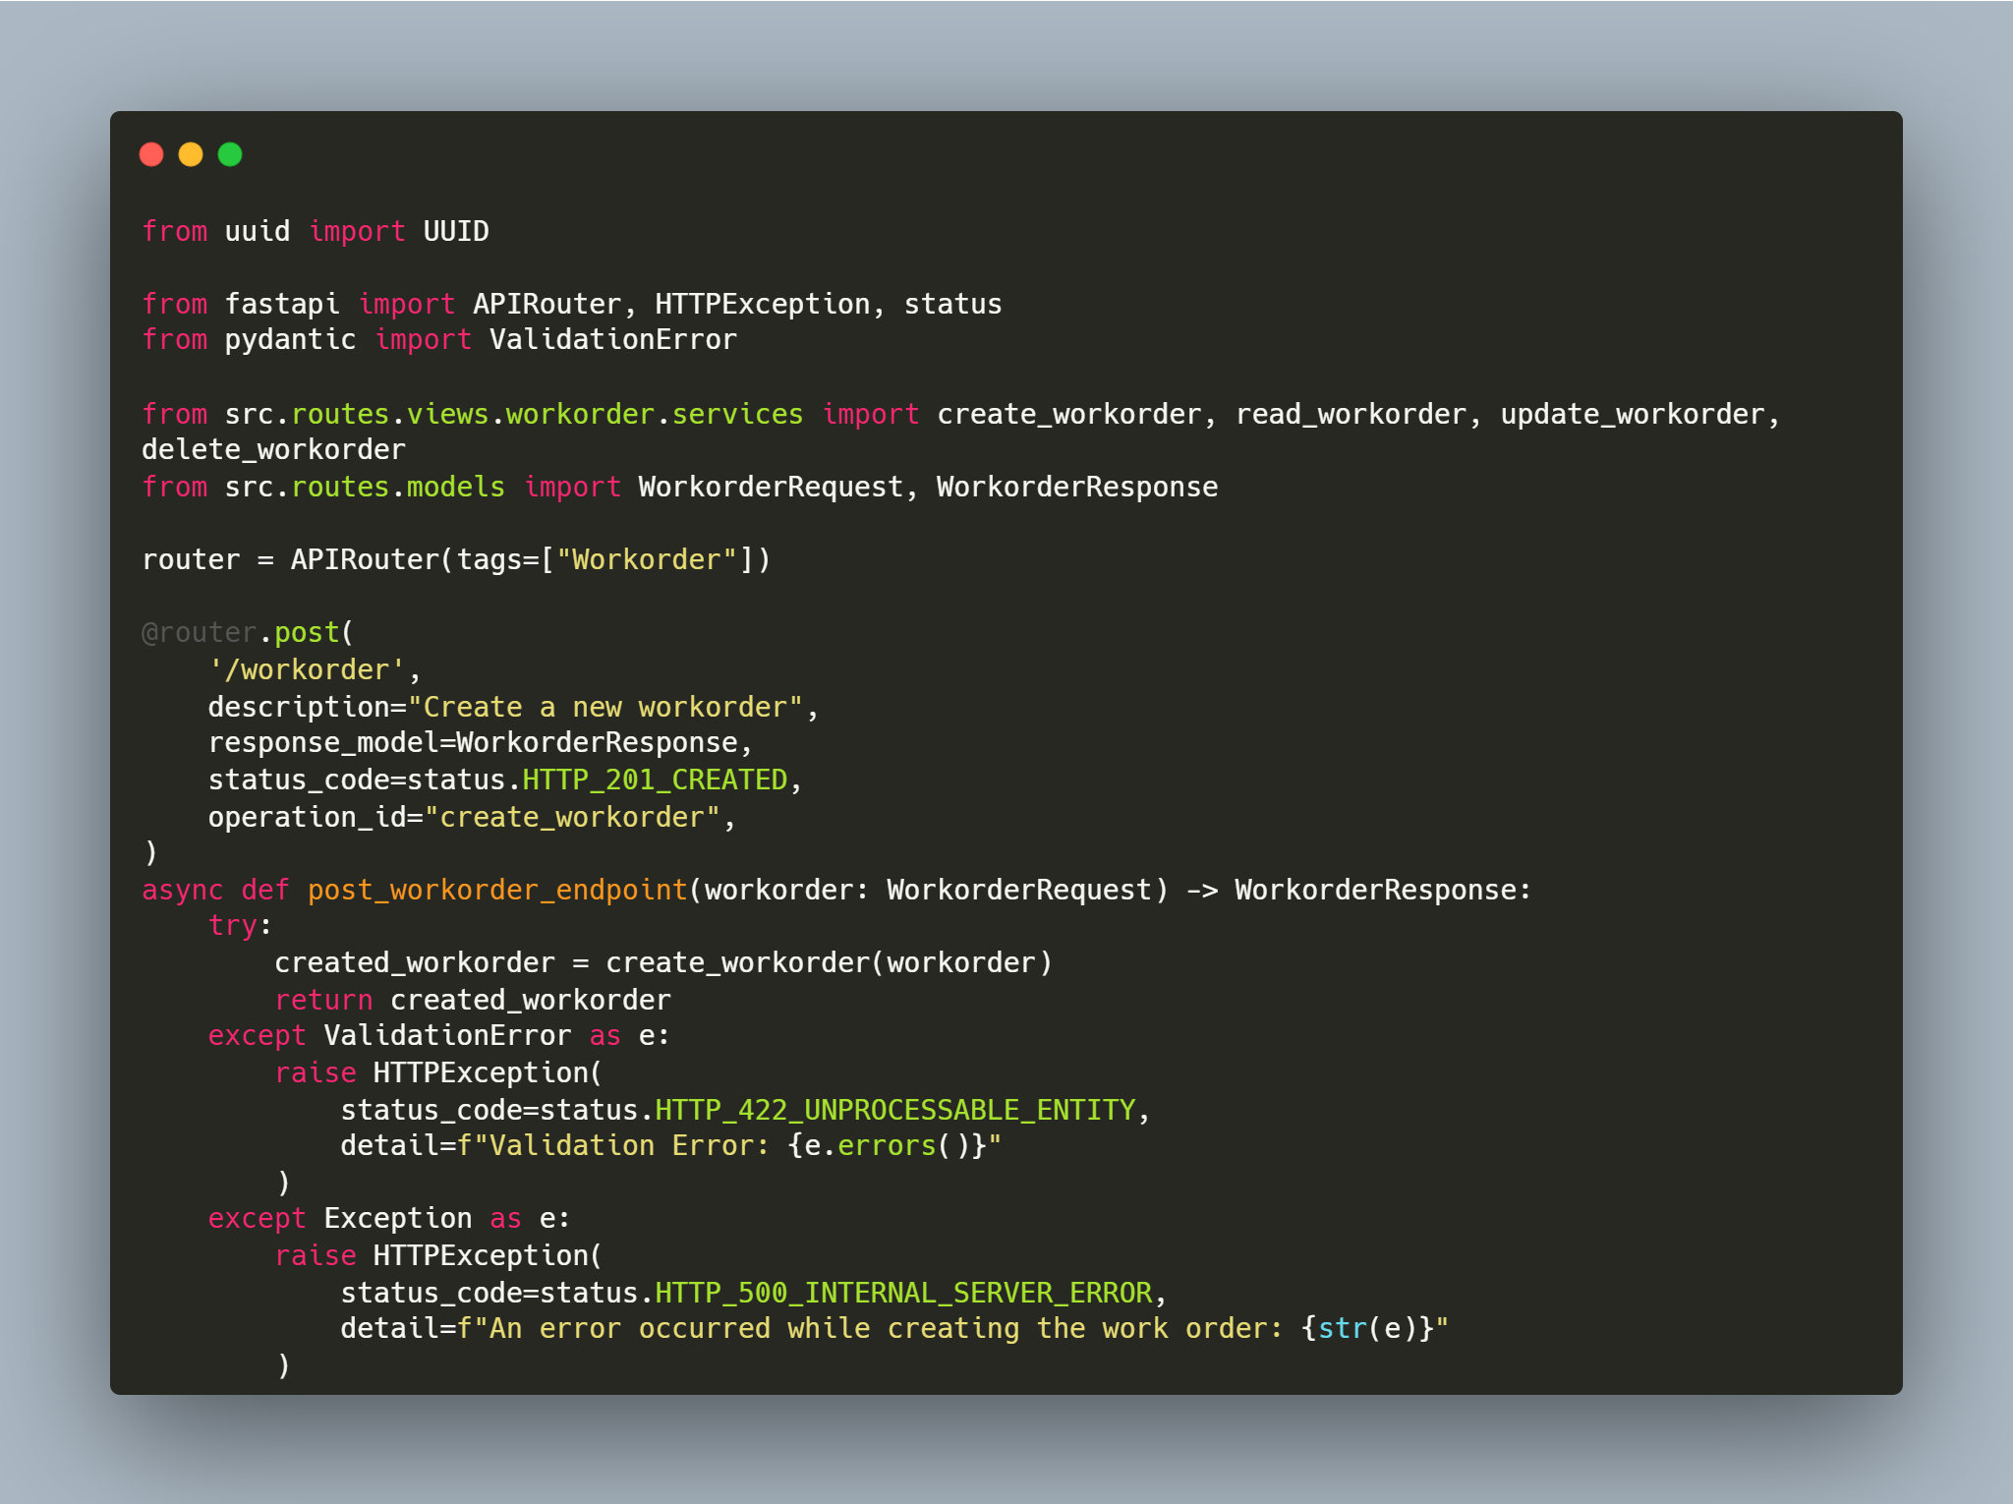
API

Slide 7
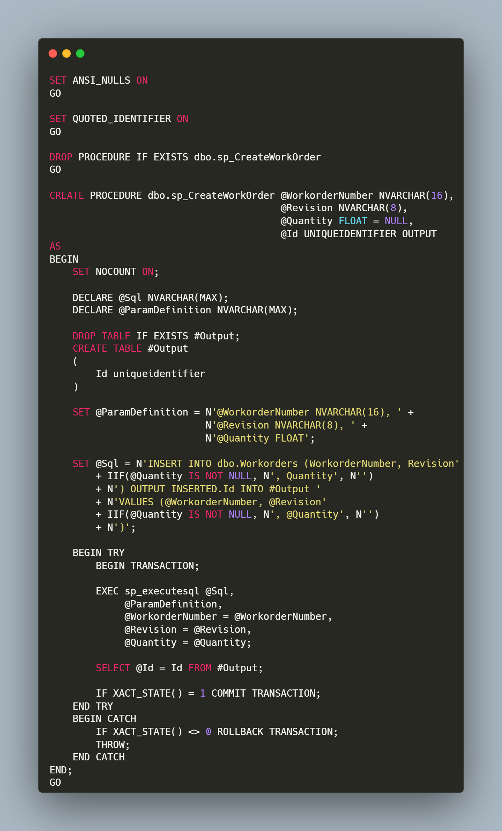
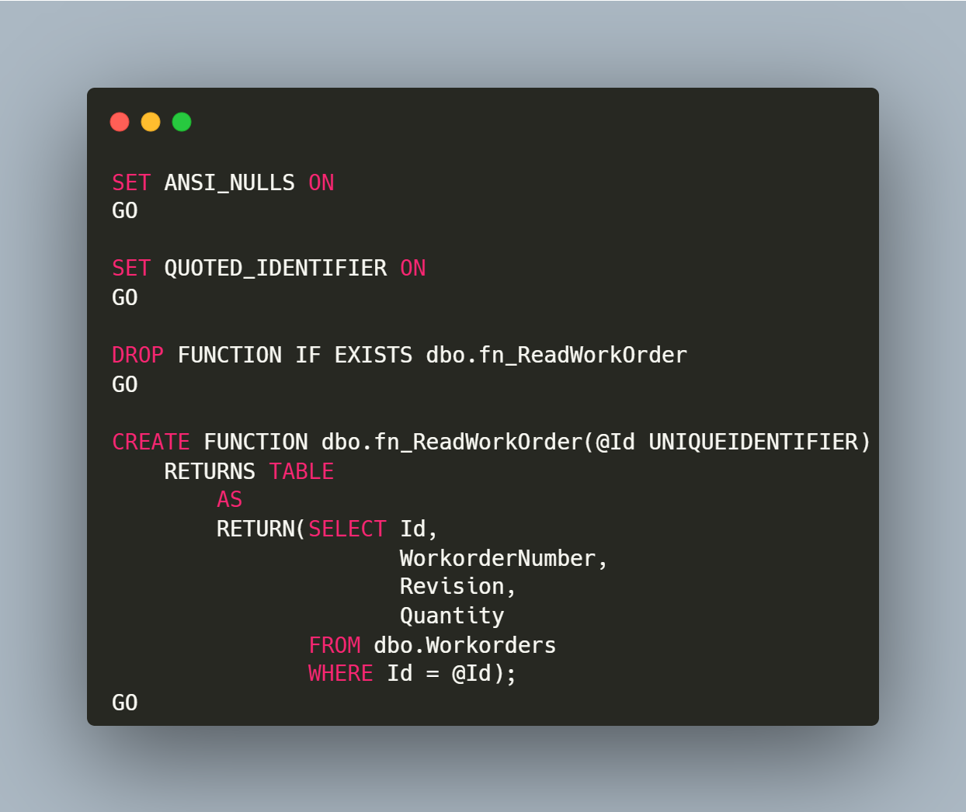
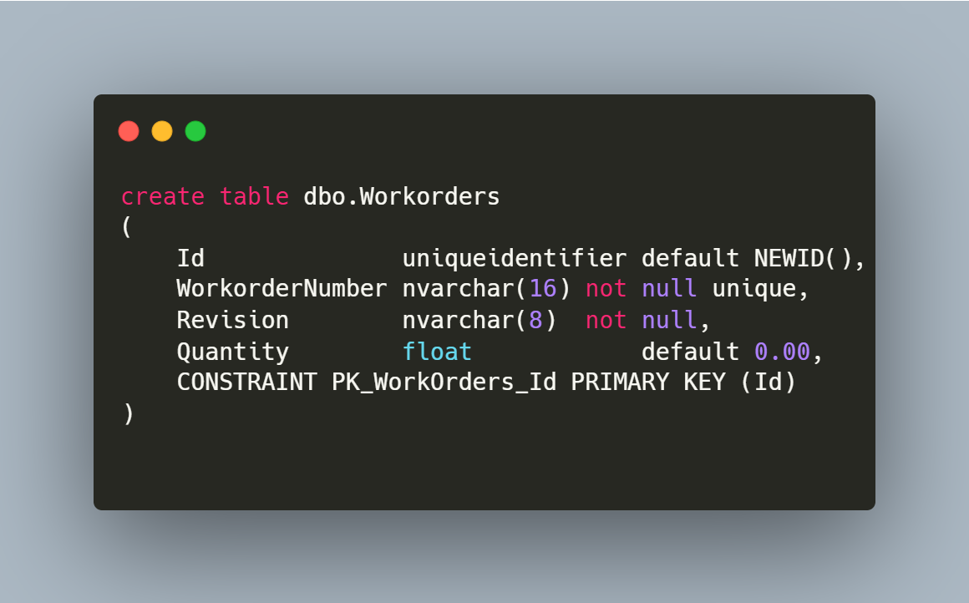
SQL Server

Slide 8
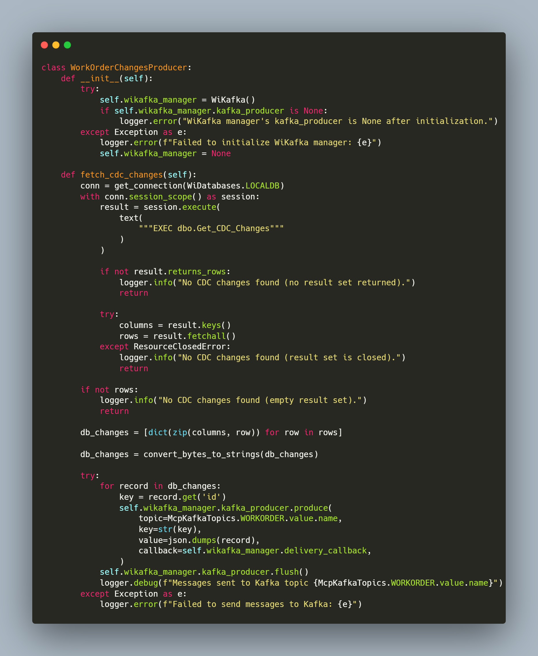
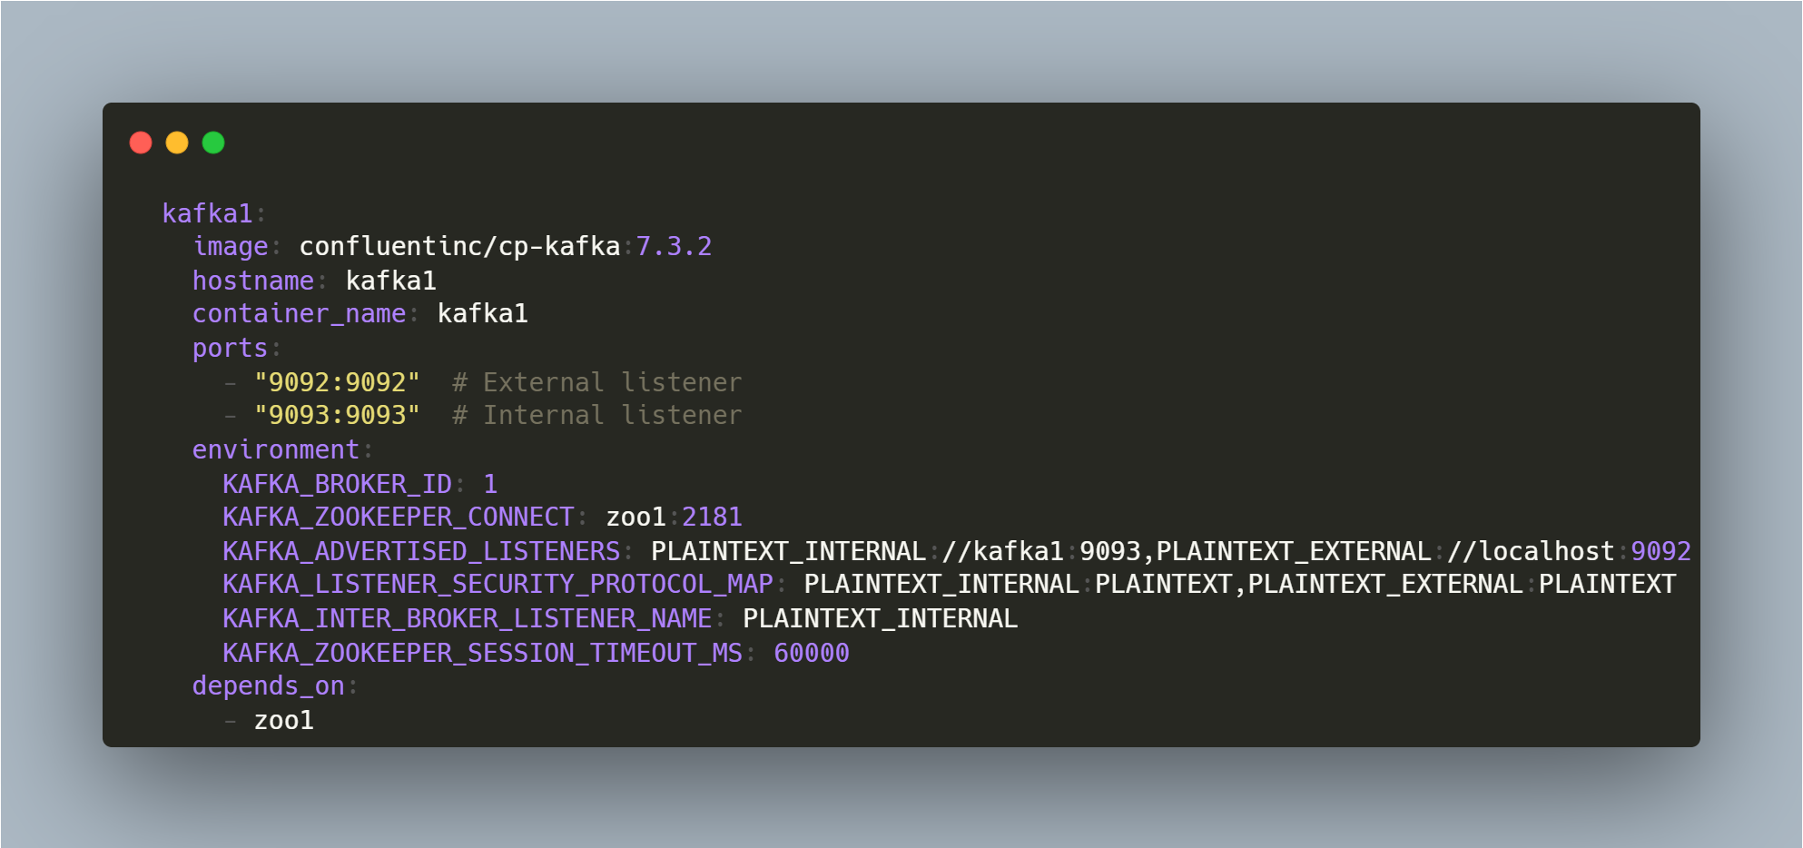
Kafka

Slide 9
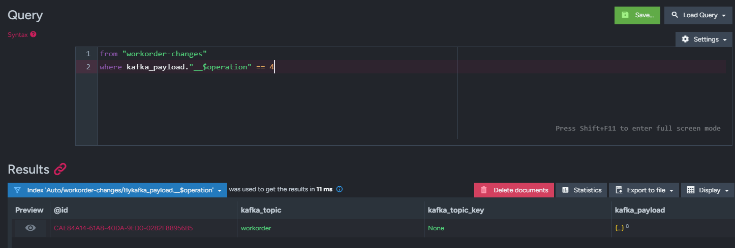
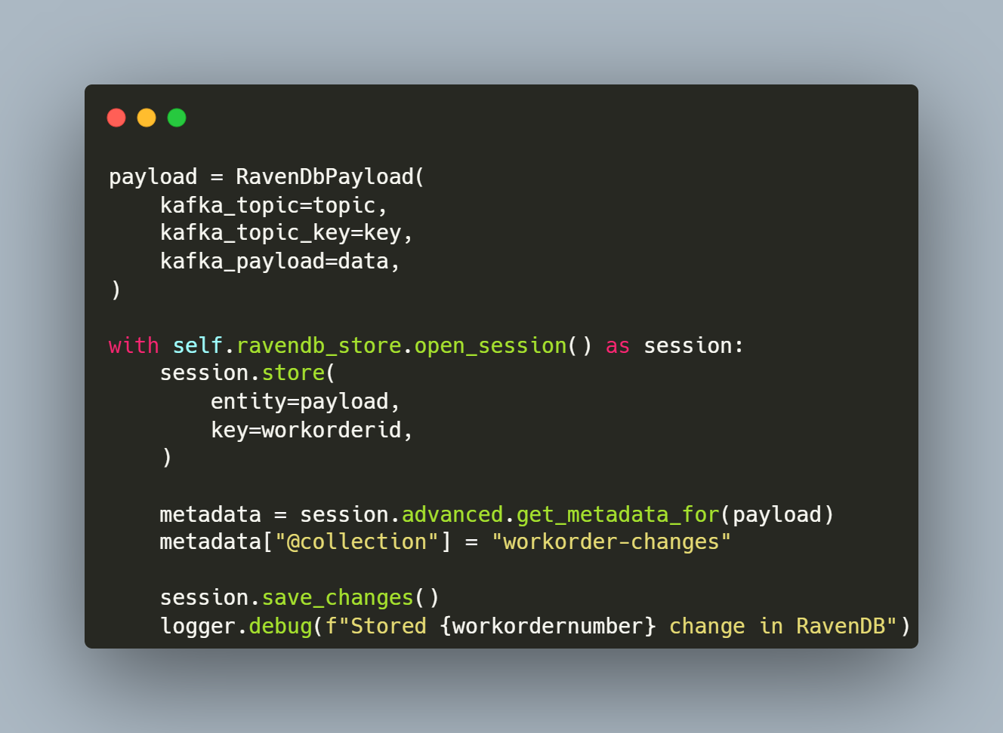
RavenDB

Slide 10
THANK YOU
Simon Lidwell​
slidwell@oakland.edu

